Slide 1
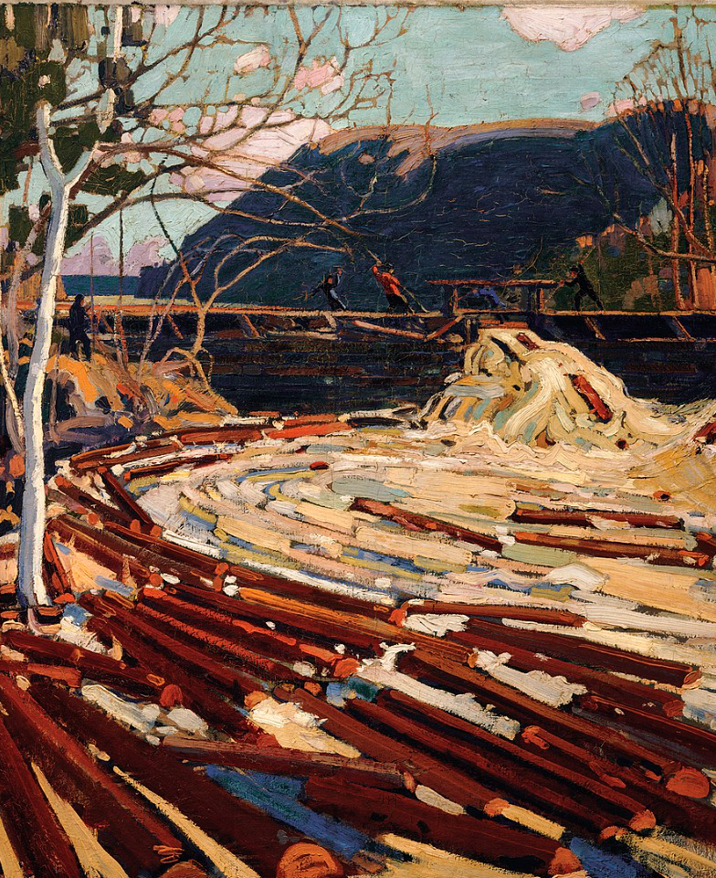

Strategy, Planning & Management
IL “Sustainability & Environmental Management” SS 25
Kami Höferl
(Thomson, 1916, PD)

Slide 2
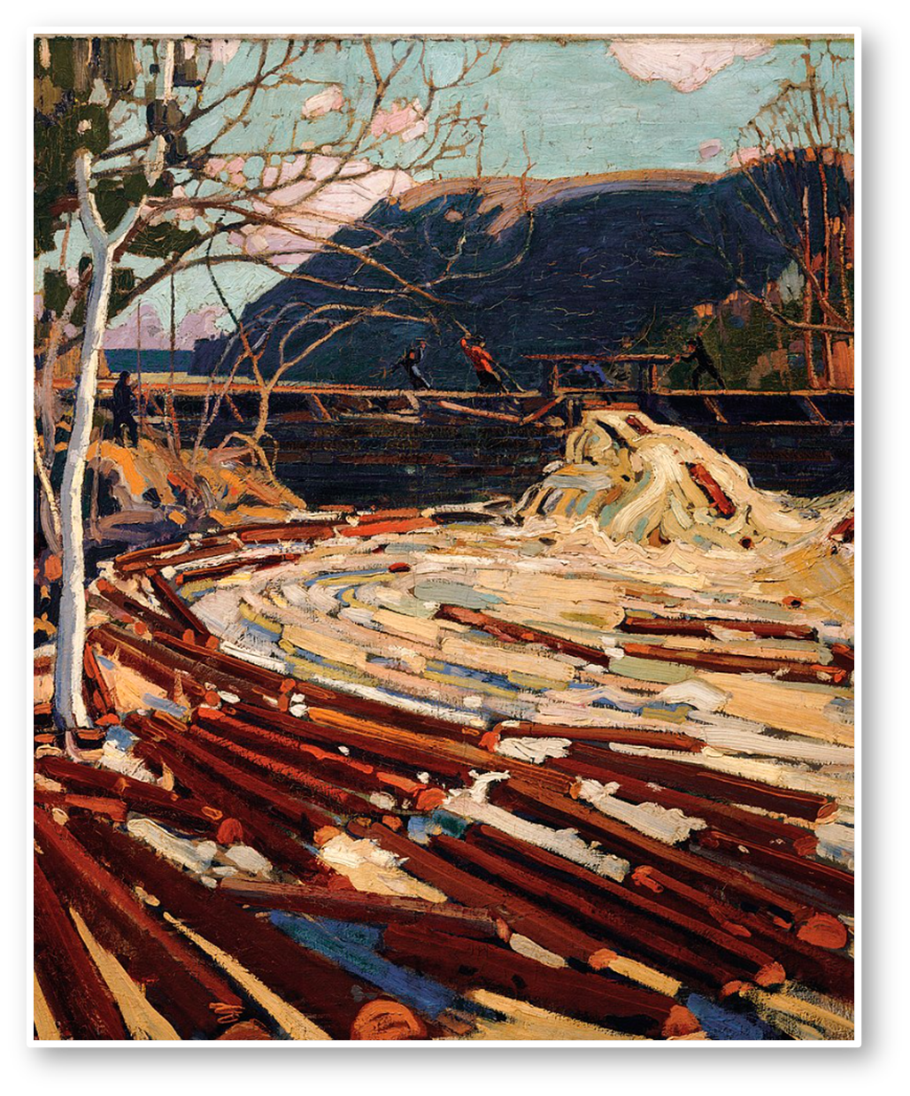
Overview
Recap: Where is the problem?
Managing our way out
Defining Environmental Management
Defining Sustainability Management
Synthesis: Sus or Enviro - or both?
(Thomson, 1916, PD)
(Escher, 1961)

Slide 3
Where is the Problem?

Slide 4
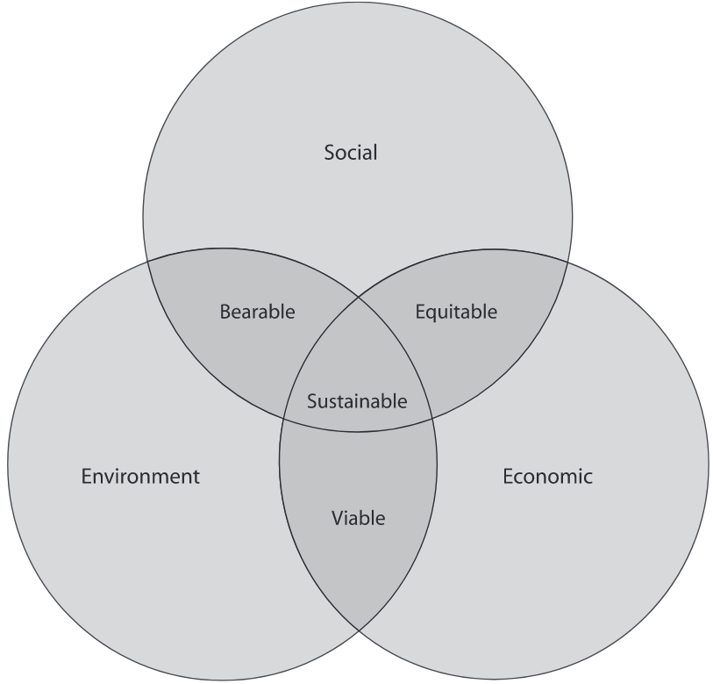
Elkington’s “Tripple Bottom Line” (1994)

Slide 5
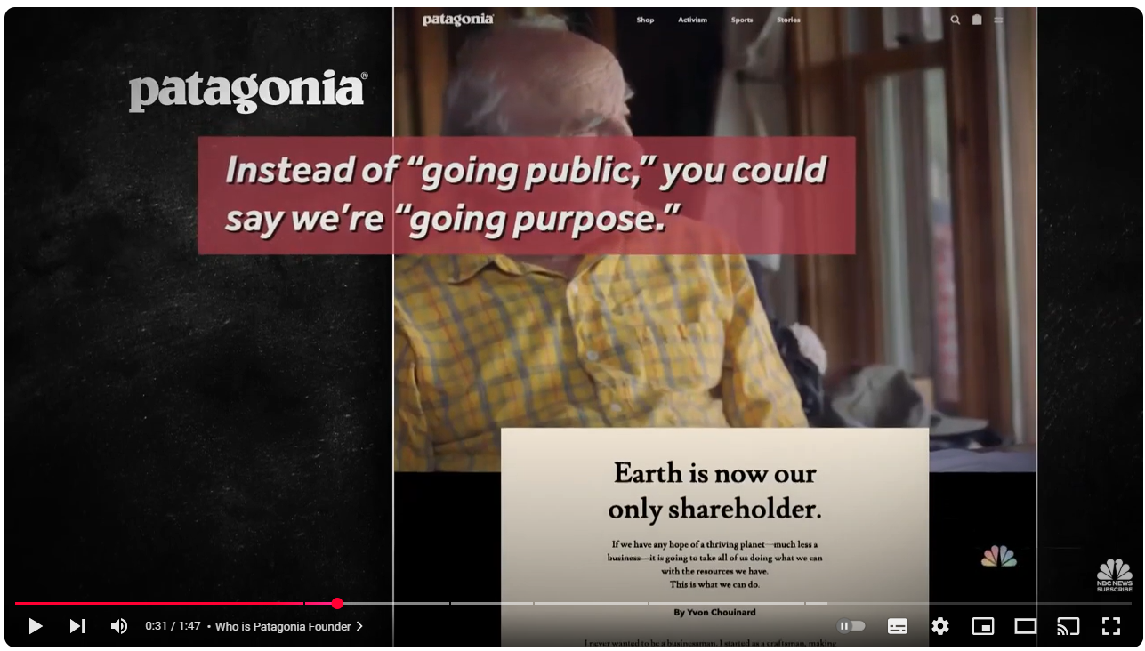
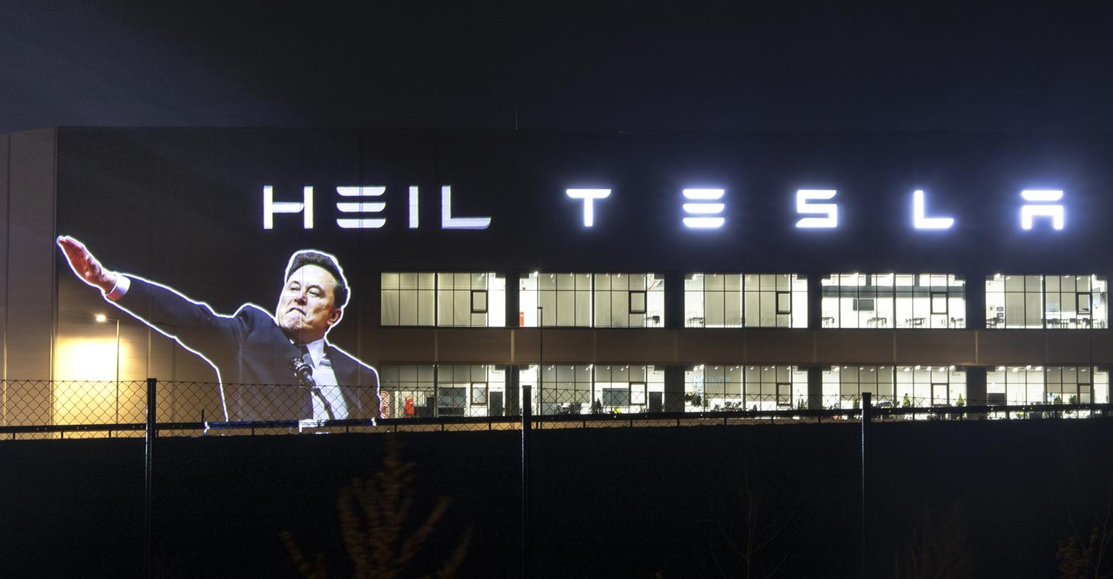
In the End: Simply apply these Principles!
Notes:
2022 ~ 100 Mio $ profit
Columbia sportswear: 223 in 2024

Slide 6
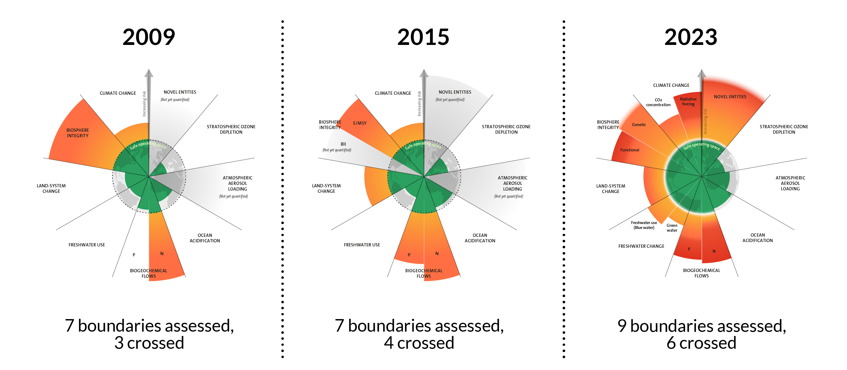
Reviewing our performance so far
(Azote for Stockholm Resilience Centre, based on analysis in Richardson et al 2023; CC BY-NC-ND)

Slide 7
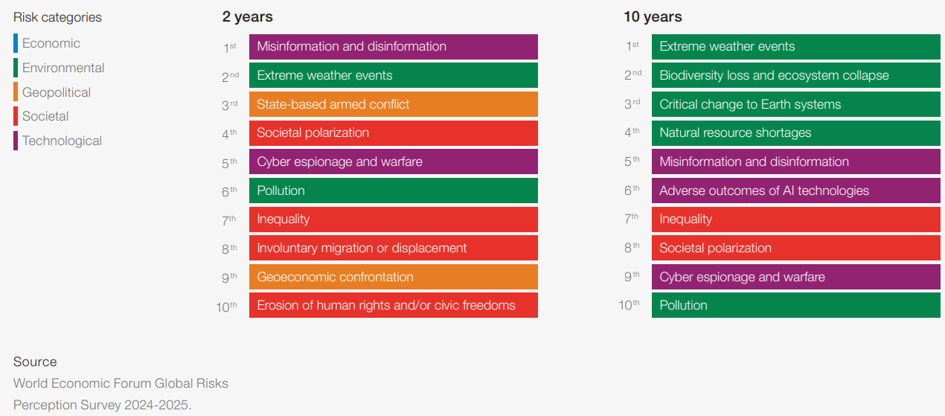
And looking ahead: The WEF-Perspective (2025)

Slide 8
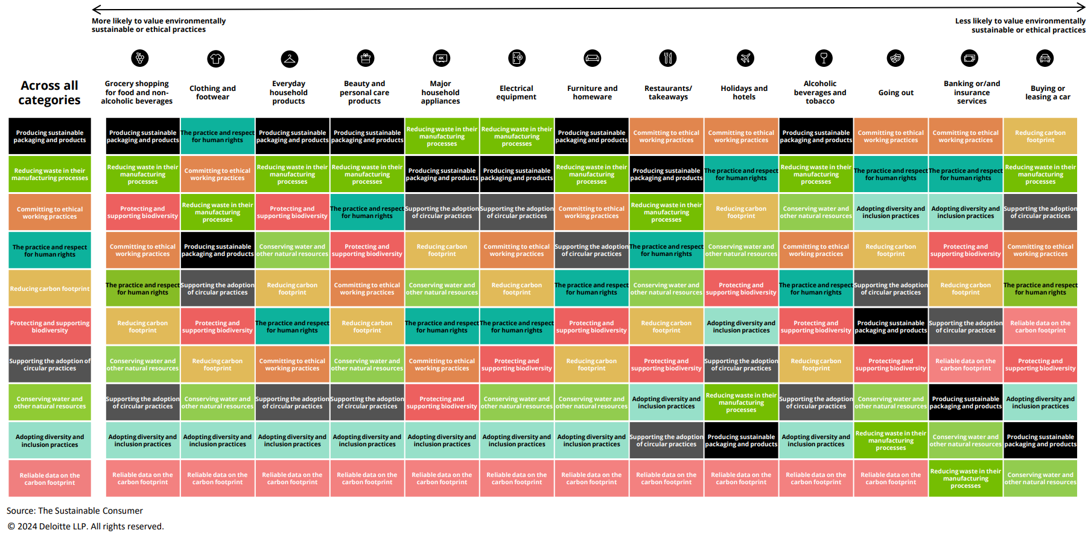
Why is it that hard?
Importance of environmentally sustainable and ethical values, by products and services

Slide 9
Can’t we manage our way out? Part I

Slide 10
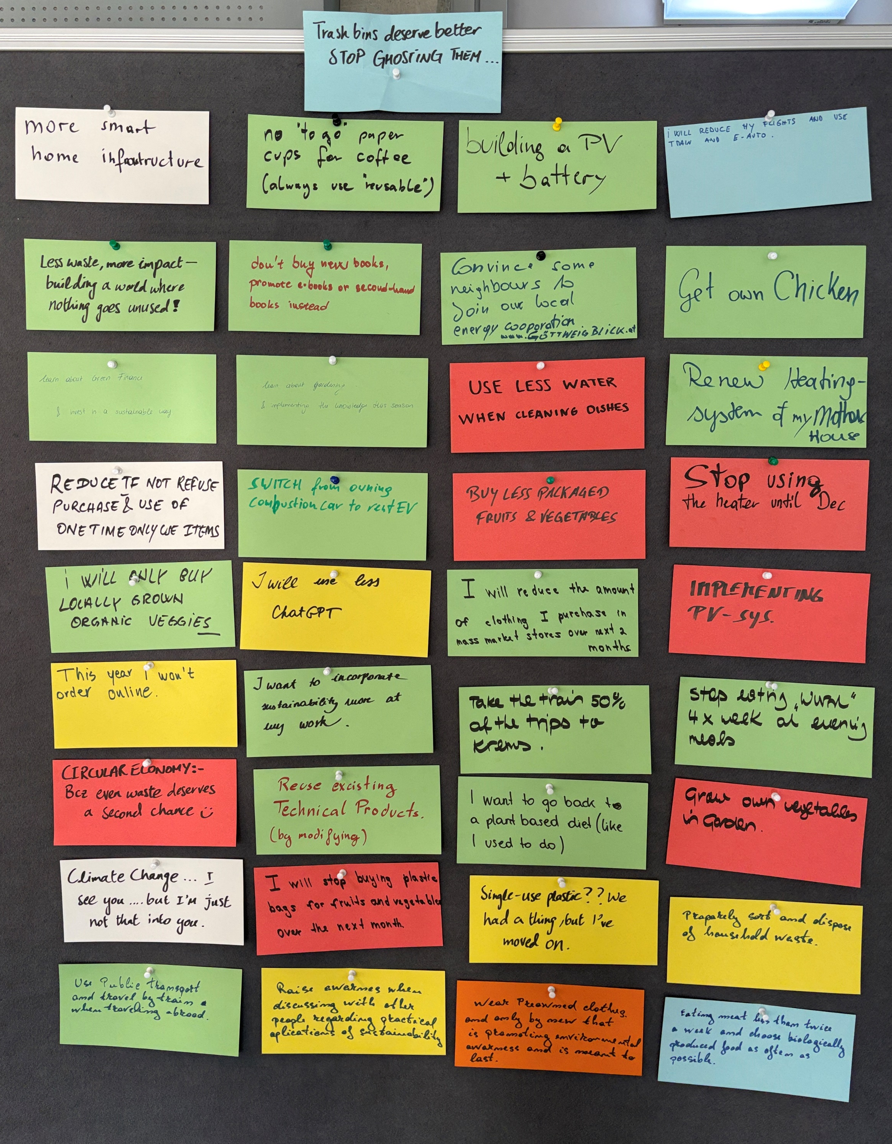
Let’s start here and now:
What are your personal SMART commitments to sustainability and/or circularity this year?

Slide 11
Can’t we manage our way out? Part II

Slide 12
Reviewing our Sustainability & Circularity Pledges
How did we define these pledges?
Management
Strategy
Planning
Strategic Management
Guessing
Theory
…

Slide 13
Reviewing our Sustainability & Circularity Pledges
How did we define these pledges?
Management
Strategy
Planning
Strategic Management
Guessing
Theory
…
🤔 Was this already “Sustainability Management” in action?

Slide 14
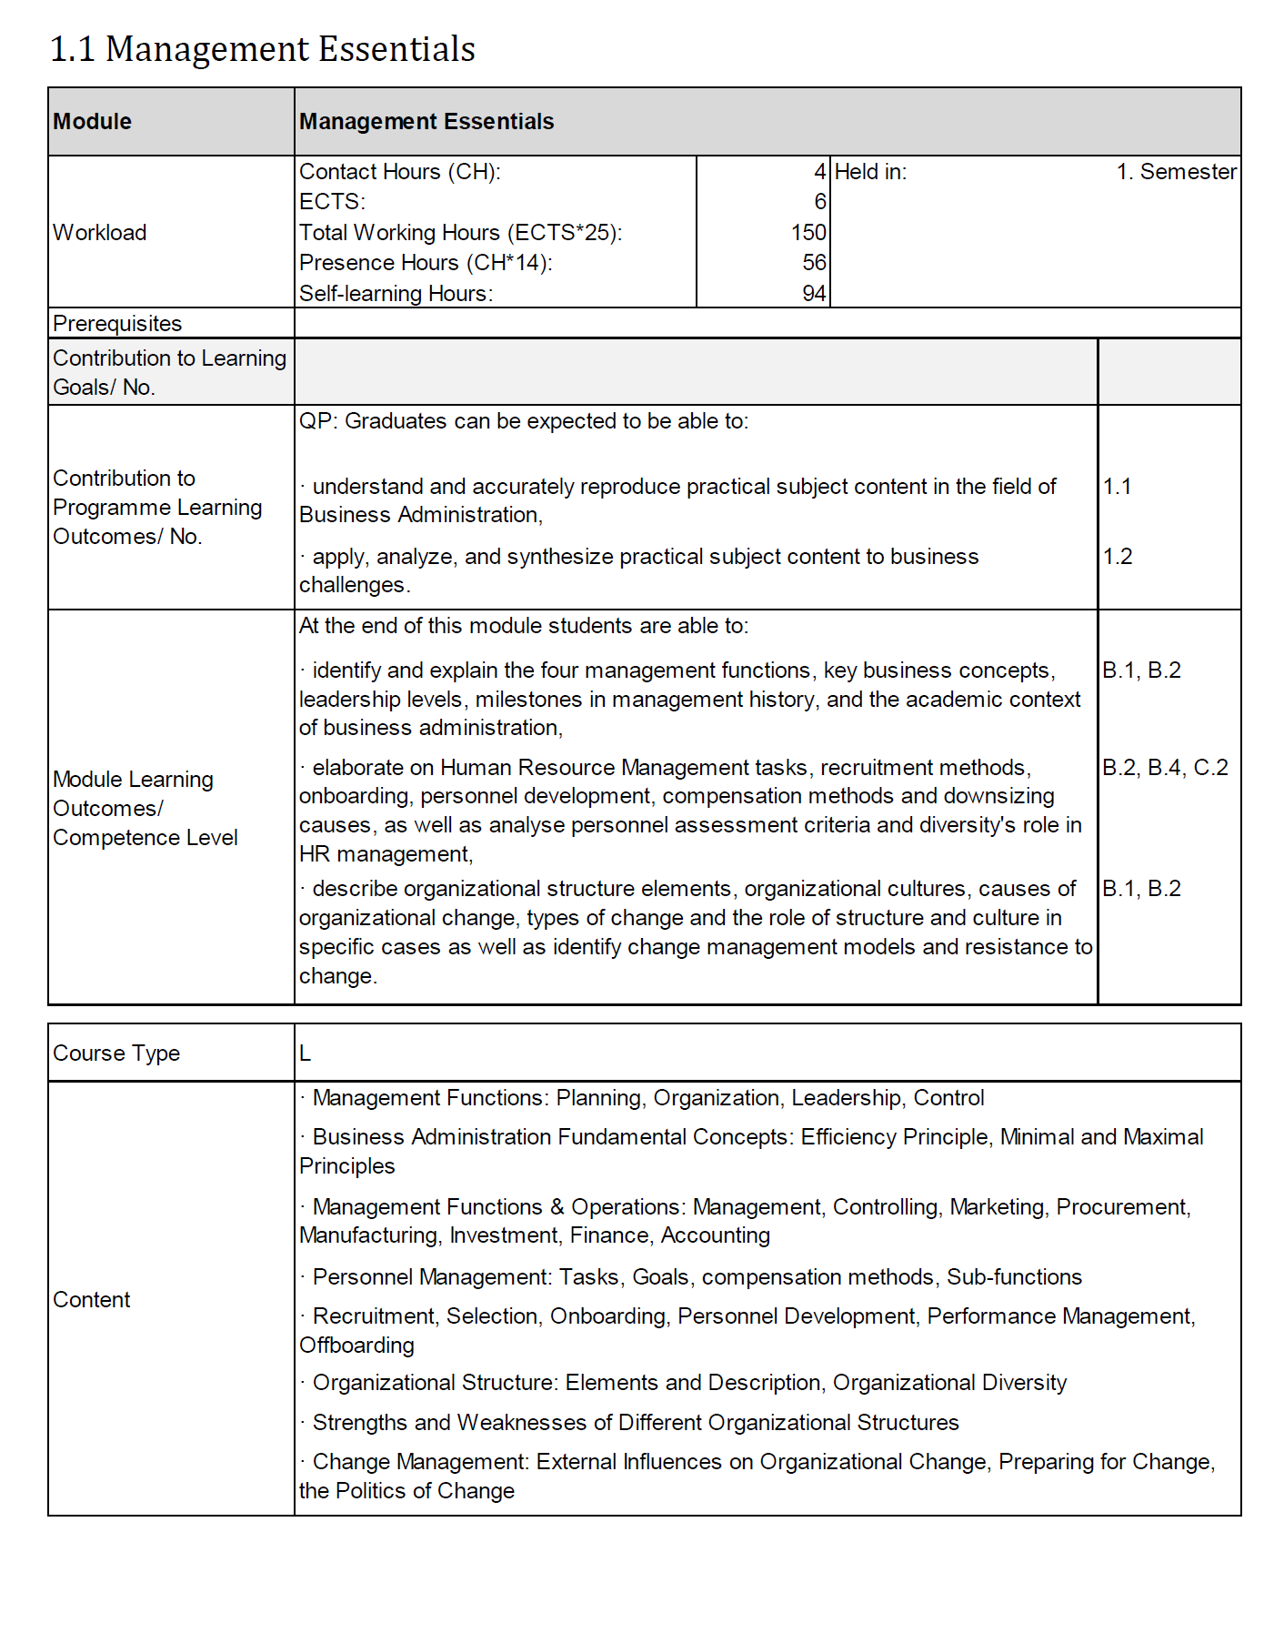
Digression: Management Essentials 👉 What is a Strategy?

Slide 15
What is a Strategy?
👉 long-term direction or plan that an organisation follows to achieve its objectives (e.g. Mintzberg, 1987; Porter, 1996)
Focus:
service delivery
competitive advantage and
positioning in a changing environment
deliberate (intended) or emergent (adapted over time)
linked to decision-making under uncertainty

Slide 16
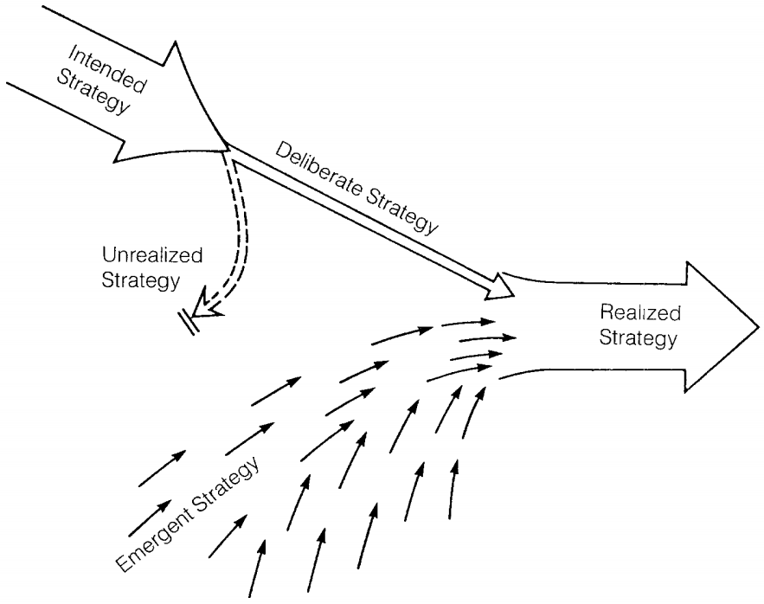
What is a Strategy?
Mintzberg’s (1987) 5 Ps:
Plan: A structured course of action
Pattern: Consistency in behaviour over time
Ploy: A manoeuvre to outcompete rivals
Position: Place in the market or sector
Perspective: A guiding philosophy or mindset.

Slide 17
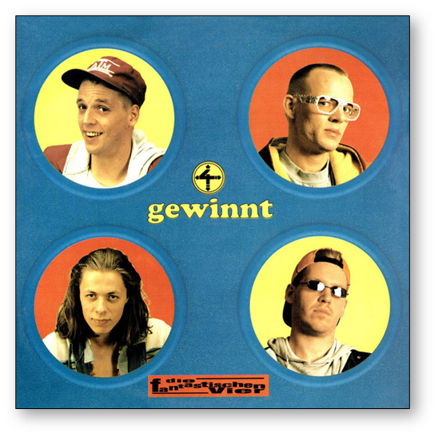
What is a Strategy?
Mintzberg’s (1987) 5 Ps:
Plan: A structured course of action
Pattern: Consistency in behaviour over time
Ploy: A manoeuvre to outcompete rivals
Position: Place in the market or sector
Perspective: A guiding philosophy or mindset.

Slide 18
Rational Perspective: Strategy = Plan
Military theory (von Clausewitz, 1832):
Long-term fundamental decisions vs. short to medium-term implementation (= tactics)
Game theory Nash, 1950):
Instructions for action in order to be prepared for all conceivable moves of the opponent
Business perspective (Mintzberg, 1978):
Formalised process → determines goals & means to position companies successfully against competitors
→ rational approach to identify & pursue goals

Slide 19
What Strategies do
Organise & simplify "processes":
Reduction of complexity 👉 consistent behaviour
Set priorities 👉 "Why?"
Provide points of reference 👉 Orientation (= alignment) for stakeholders
Materialise themselves in:
Mission statements
Goals
Programmes & plans
Projects
Artefacts
Actions

Slide 20
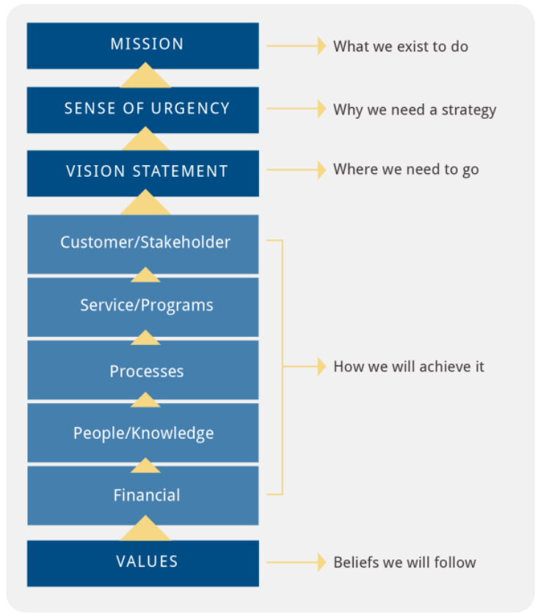
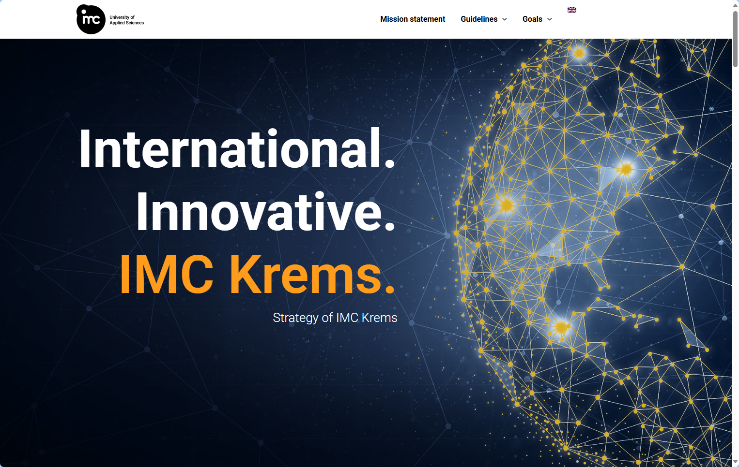
What Strategies do in Action I

Slide 21
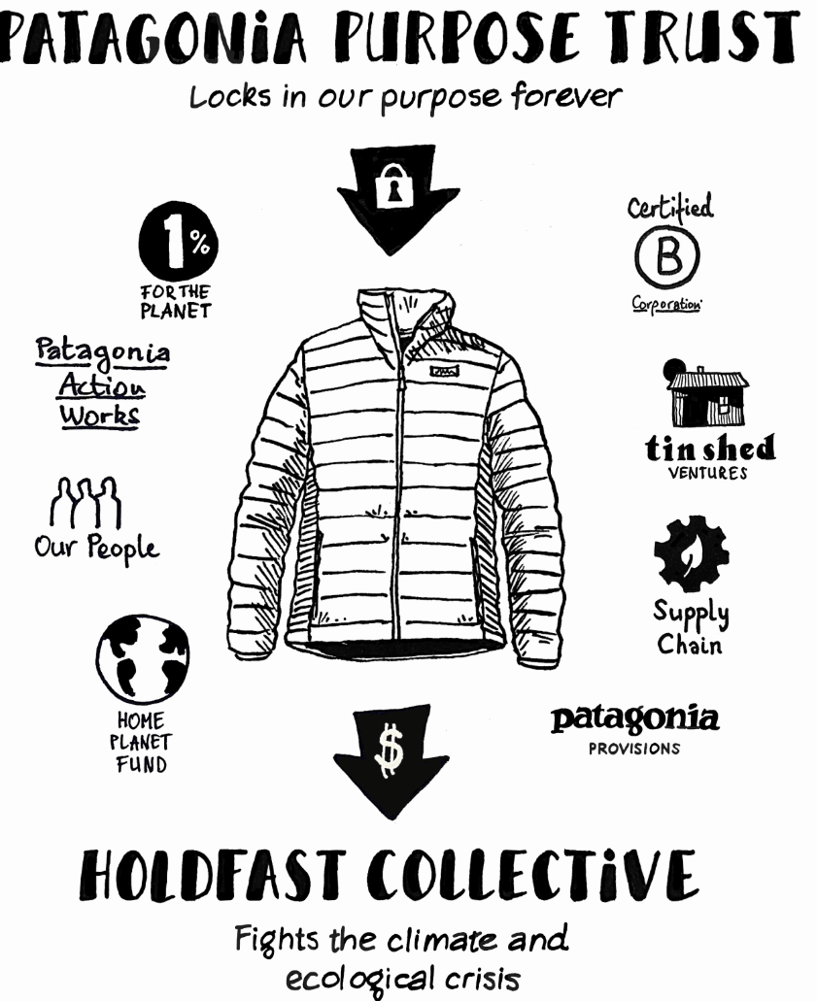
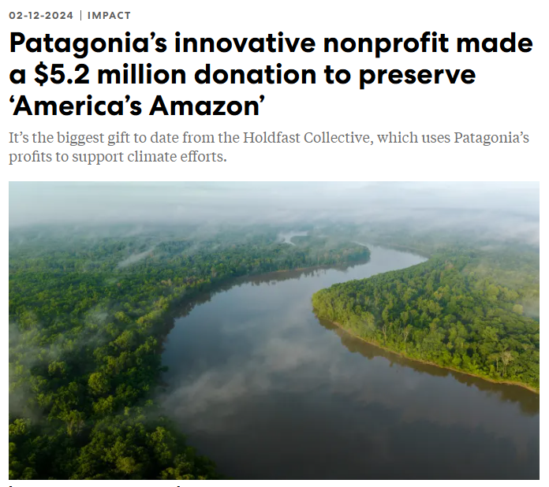
What Strategies do in Action II
Organise & simplify "processes“ Patagonia-style: Earth is our only shareholder
Reduction of complexity
Set priorities
Provide points of reference
Materialise themselves in:
Mission statements: A Letter from Yvon Chouinard
Goals
Programmes & plans
Projects
Artefacts
Actions

Slide 22
Reviewing our Sustainability & Circularity Pledges
How did we define these pledges?
Management
✅ Strategy
Planning
Strategic Management
Guessing
Theory
…
🤔 Was this already “Sustainability Management” in action?

Slide 23
What is Planning?
🤔

Slide 24
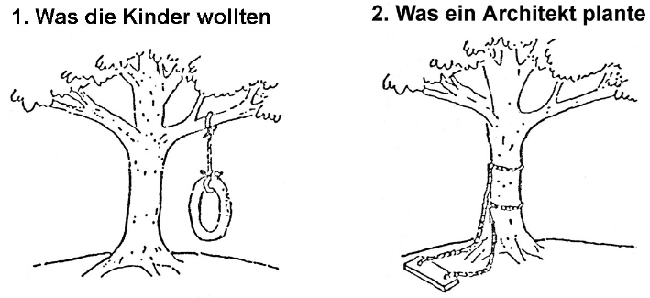

What is Planning?
What the kids wanted What the architect planned

Slide 25
What is Planning?
👉 no universal definition (as always …):
The systematic procedure for developing action goals and sequences of actions over a longer period of time.
The mental anticipation or deliberative forethought of future actions.
The foresighted, coordinative activity with the aim of optimising processes of procedures
Notes:
Planning is about how to achieve objectives, while strategy is about what and why.

Slide 26
What is Planning?
“The term planning encompasses procedures for increasing rationality in complex decision-making and action processes, by applying rational methods to the formulation of […] goals and their implementation in concrete action programmes.“ (Läpple, 2006)
Description & explanation of the initial situation
formulation of goals
development of alternative courses of action
the operationalisation

Slide 27
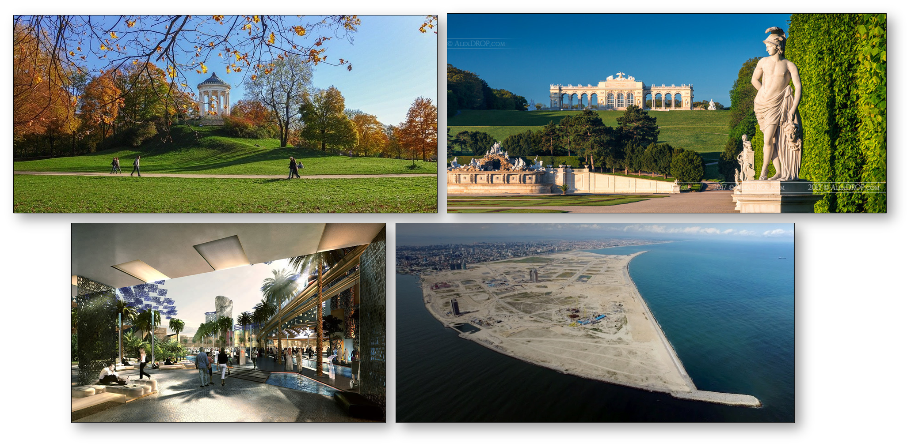
Is this Planning in Action?
Notes:
# Englischer Garten München: 1789 aus Militärgärten einen Volkspark (Teiche, Ruheplätze, Denkmäler) zur Erbauung der Bürgerschaft vom Herrscher geöffnete Flächen (Prater, Augarten)
# Schloss Schönbrunn: 1695 geplant, 1752 Tiergarten (für Sissi). Gloriette: 1770 Entwurf für Brunnen, aber zu wenig Wasser, 1775 Gloriette erbaut (ink. Hügerlaufschüttung und Rodungen)
# Masdar City - Vereinigte Arabische Emirate
+ 6 km2 / 18-22 Mrd. $
# Lagos 10 mio+: Eko Atlantic City
+ 250.000 EW / 10km2
+ IBK: hälfte der Bev / 3x die Fläche (Dauersiedlungsraum)

Slide 28
Reviewing our Sustainability & Circularity Pledges
How did we define these pledges?
Management
✅ Strategy
✅ Planning
Strategic Management
Guessing
Theory
…
🤔 Was this already “Sustainability Management” in action?

Slide 29
What is Management?
🤔

Slide 30
What is Management?
👉 the process of coordinating people, resources, and activities to achieve organisational goals (Fayol, 1916; Drucker, 1954)
Needs: decision-making, organising, leading & controlling
Differences to strategies & plans:
Focus is the efficient execution of plans and strategies

Slide 31
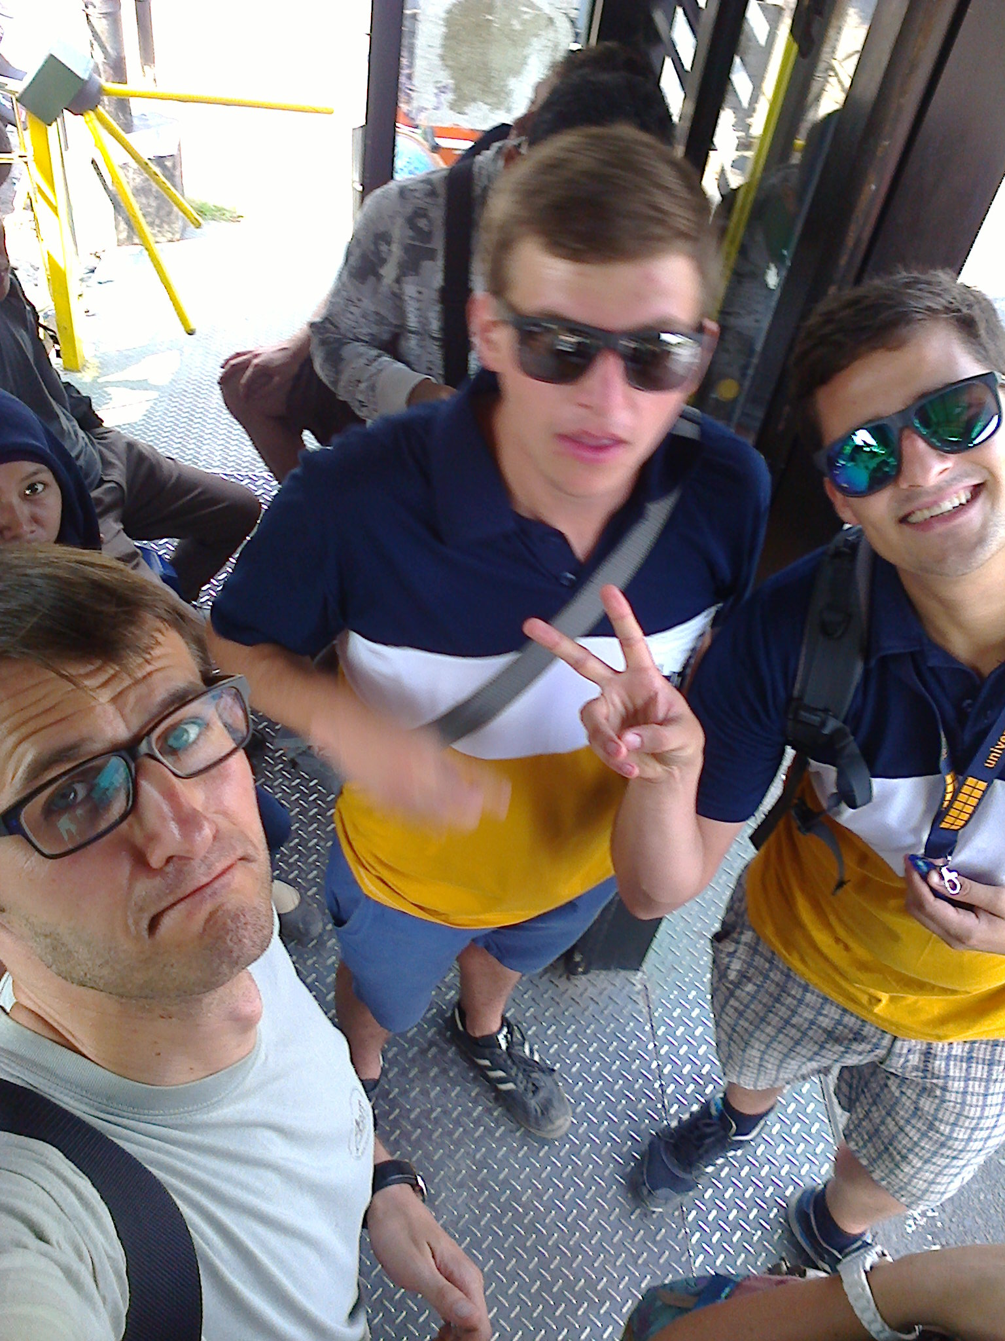
What is Management?
Fayol’s (1916) 5 Functions of Management:
Planning: Setting objectives and defining methods
Organising: Allocating resources and roles
Leading: Motivating and directing teams
Coordinating: Ensuring alignment and integration
Controlling: Monitoring and correcting performance (= evaluation)

Slide 32
Reviewing our Sustainability & Circularity Pledges
How did we define these pledges?
✅ Management
✅ Strategy
✅ Planning
Strategic Management
Guessing
Theory
…
🤔 Was this already “Sustainability Management” in action?

Slide 33
So: Strategy, Planning & Management I
Strategy, Planning, and Management = interdependent concepts that guide organisational success
Strategy: long-term vision and competitive positioning 👉 What & Why?
Planning: translates strategy into structured steps and resource allocation 👉 How & When?
Management: ensures the execution of plans & strategies through organisation, leadership, and control 👉 Who & How Well?

Slide 34
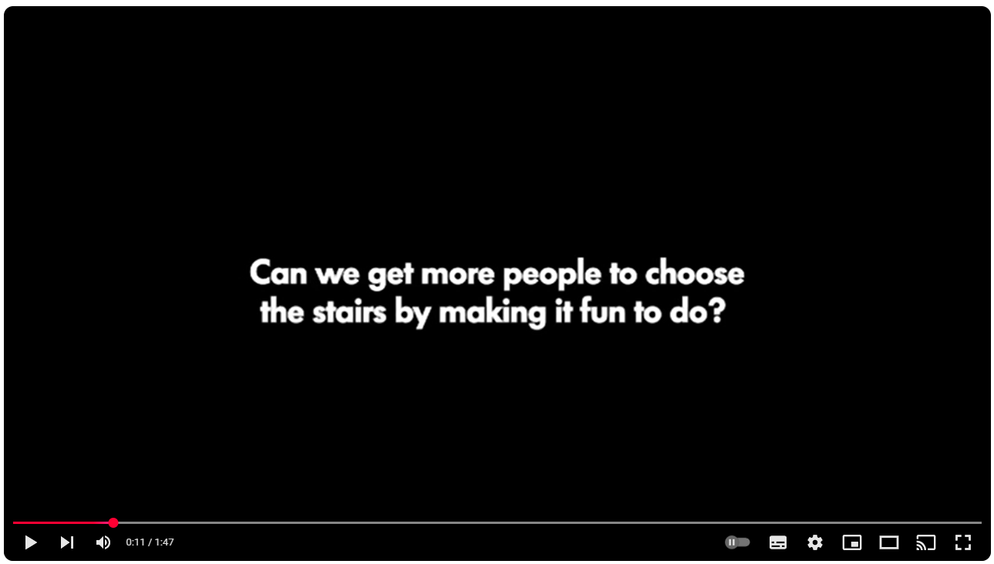
Strategy, Plan & Management: Let’s recheck!

Slide 35
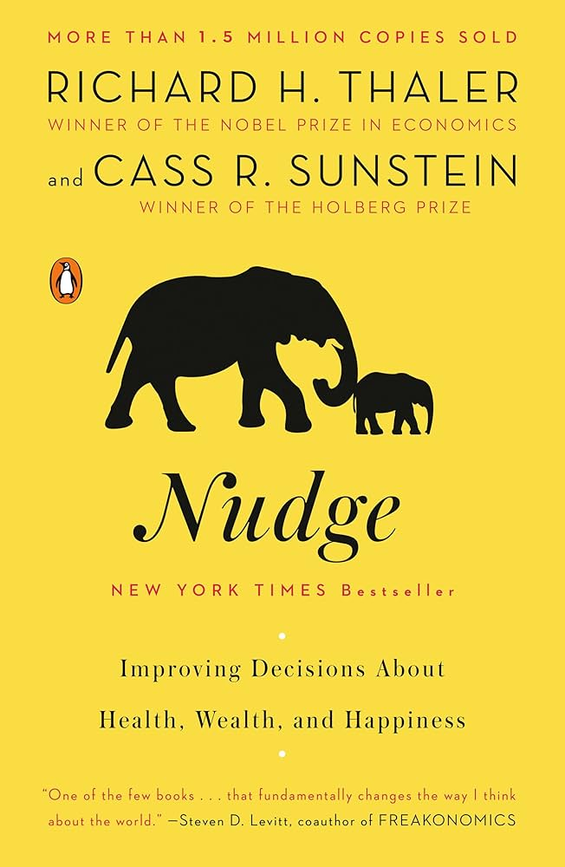
Strategy, Plan & Management: Let’s recheck!
Strategy:
Goal: Use the stairs
options to reach it
Repressive power
Provide information
Nudging: Libertarian Paternalism
…

Slide 36
So: Strategy, Planning & Management II
Strategy, Planning, and Management = interdependent concepts that guide organisational success
Strategy without Planning 👉 lacks structure & feasibility
Planning without Strategy 👉 inefficiency & misalignment with goals
Management without Strategy & Planning 👉 aimless execution & poor resource use

Slide 37
Square 1: Environmental Management

Slide 38
What is Environmental Management?
🤔

Slide 39
What is Environmental Management?
👉 “older” (pre-sustainability) management approach
systematic approach to minimizing environmental impacts and ensuring the sustainable use of natural resources through policies, regulations, and management strategies
Classic approaches:
Ensuring compliance with environmental laws and policies
Identifying and mitigating environmental risks
Implementing Environmental Management Systems (EMS) like EMAS or ISO 14001
🔗 Promoting sustainability through pollution prevention, waste management & resource efficiency

Slide 40
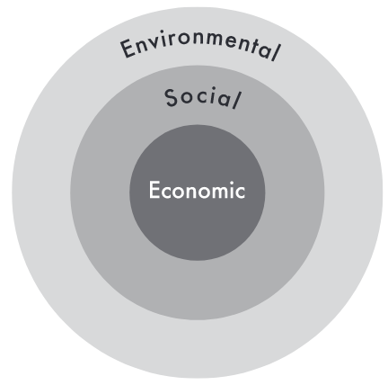
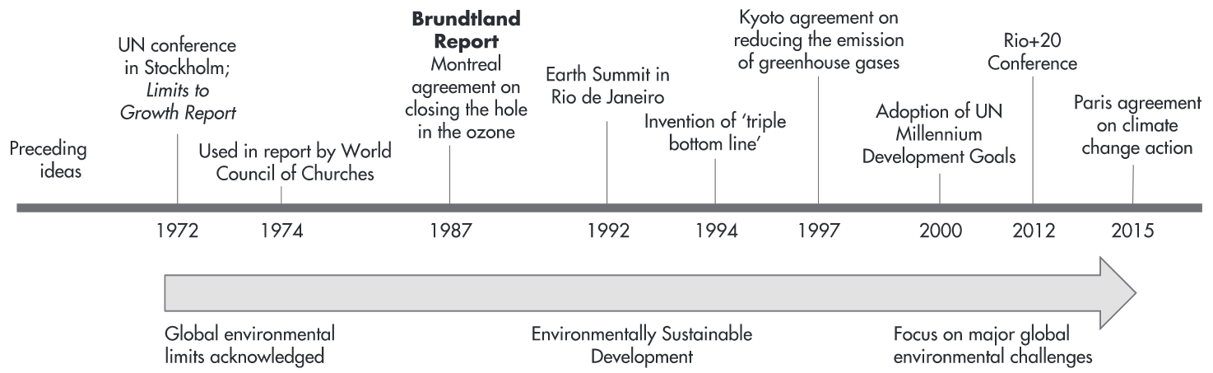
Why “older” (pre-sustainability) Management Approach?
Notes:
1972: Erste UN-Umweltkonferenz (Stockholm)
1972 Limits of Growth
1977 in Hameln: HH Atomkraftgegner
Jahreswechsel 1983 zu 1984: Besetzung Stopfenreuther Au bei Hainburg

Slide 41
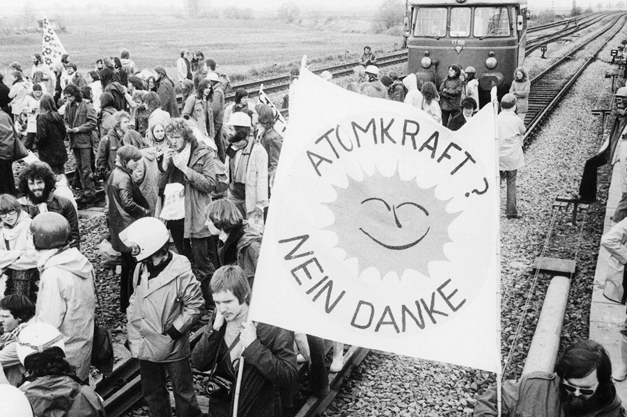
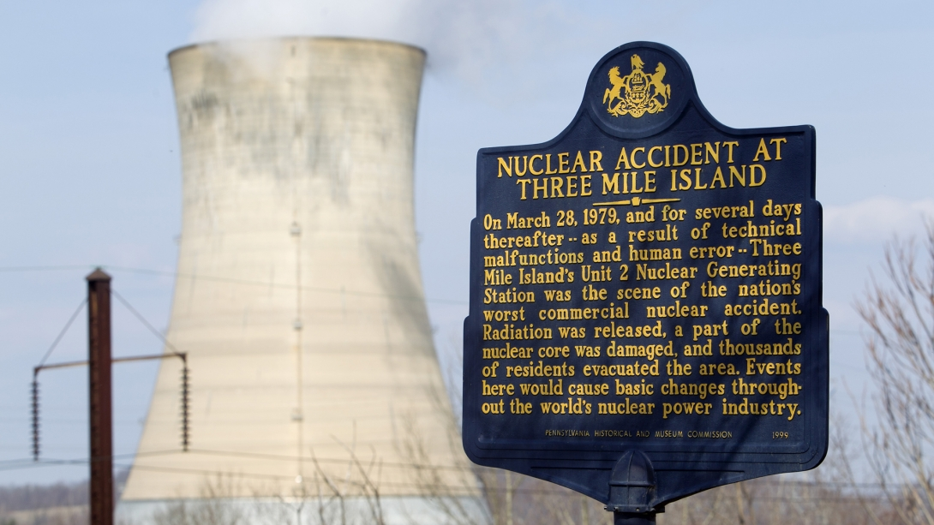
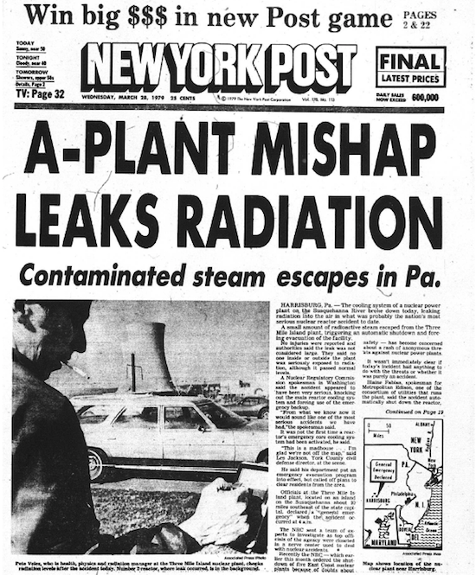

Why “older” (pre-sustainability) Management Approach?
Notes:
1972: Erste UN-Umweltkonferenz (Stockholm)
1972 Limits of Growth
1977 in Hameln: HH Atomkraftgegner
1979 Three Mile Island: Exelon Corporation, 2022: constellation energy
👉 stricter corporate environmental responsibility
900 Mio in decommissionin fund (ratepayer & comany contributions) 👉 required: 1.4 billion

Slide 42

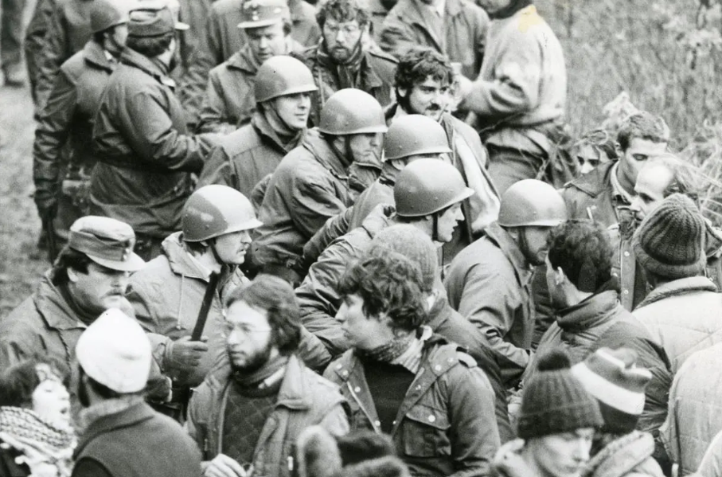
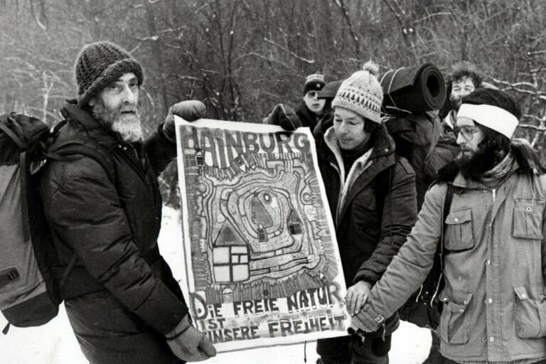
Why “older” (pre-sustainability) Management Approach?
Notes:
1972: Erste UN-Umweltkonferenz (Stockholm)
1972 Limits of Growth
1977 in Hameln: HH Atomkraftgegner
Jahreswechsel 1983 zu 1984: Besetzung Stopfenreuther Au bei Hainburg

Slide 43
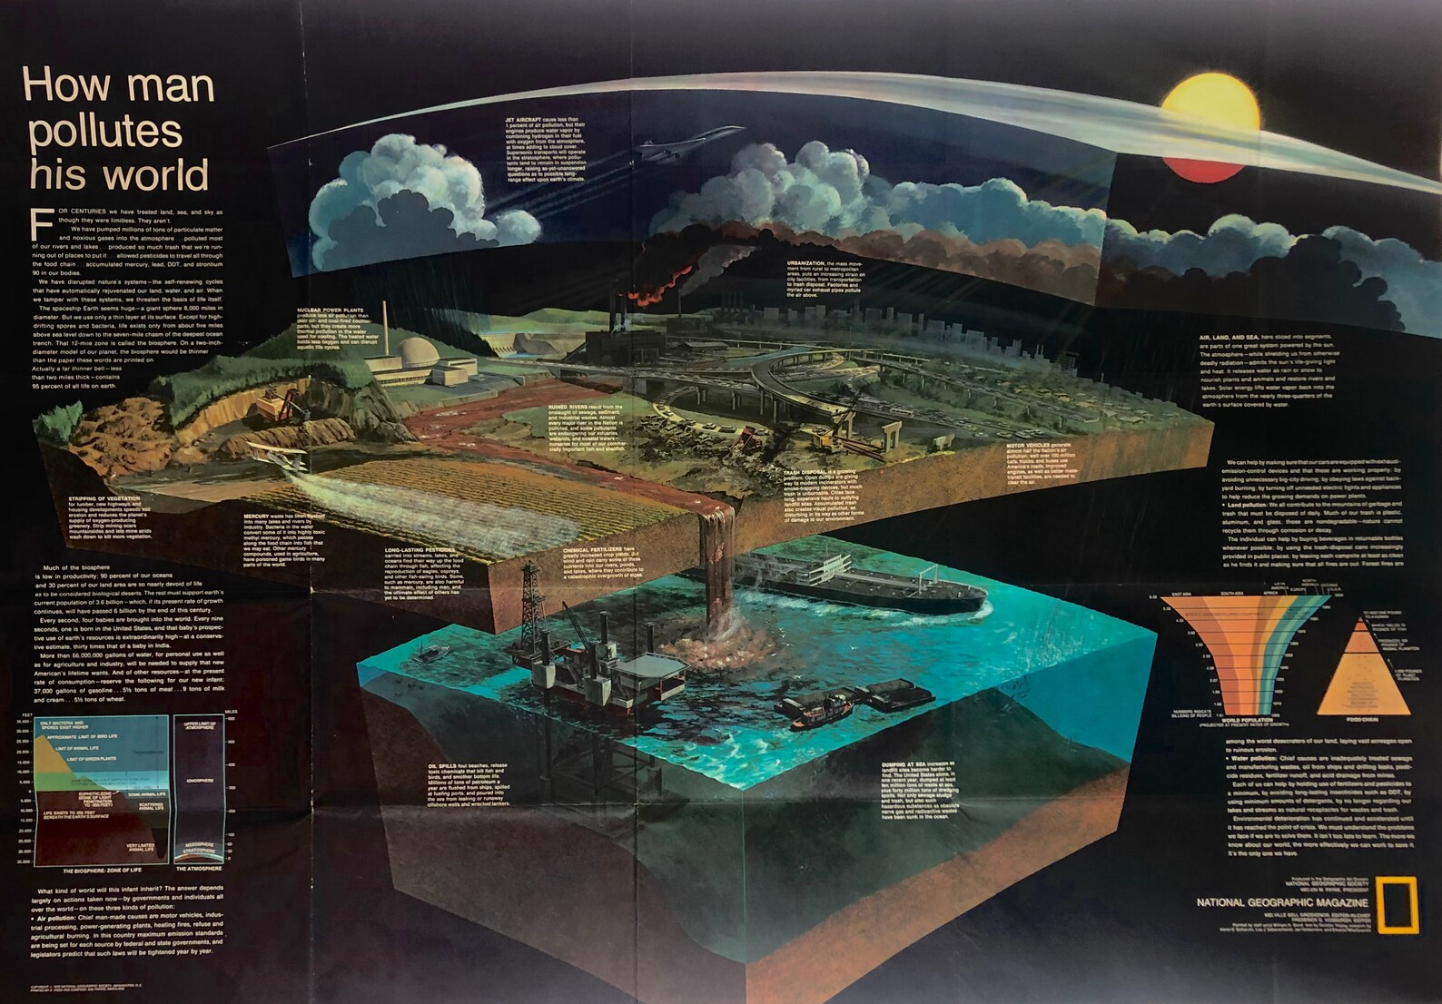
For centuries we have treated land, sea and sky as though the were limitless. They aren’t.
Notes:
1972: Erste UN-Umweltkonferenz (Stockholm)
1972 Limits of Growth

Slide 44
Digression: Nature & the Environment
Perspective 👉 | Ecological Perspective | Regulatory/Legal Perspective | Corporate Sustainability Perspective | Socio-economic Perspective | Systems Thinking Perspective
Understanding of Environment | natural environment: air, water, soil, biodiversity & ecosystems | Sum of laws & policies referring to: air, water, land, & living organisms | natural & operational surroundings affected by corporate activities | interaction between human societies & natural systems in general | complex system of interrelated natural and human-made components
Examples | Biodiversity conservation, habitat protection, ecosystem restoration | ISO 14001 Environmental Management Systems, EU Green Deal | Environmental, Social, Governance (ESG) & Corporate Social Responsibility (CSR) policies / reprtings | Sustainable cities, circular economy, climate adaptation /mitigation policies | Life Cycle Assessments (LCA), Industrial Ecology, Sustainable Supply Chains

Slide 45
Digression (again):
Thomson’s “The Drive” (1916)
logging in Algonquin Park, Canada
Transferring timber to Qttawa river
Since 1893: oldest provincial park in Canada
Earliest experiences with
Integrating timber industry in protected areas
Establishing park service management
👉 Early environmental protection movement:
1864: George Perkins Marsh’s “Man and Nature – Or, physical Geography as Modfied by Human Action”
1892: John Muir founds the “Sierra Club” to protect the country’s “wilderness”

Slide 46









Who is in Charge?
👉 Companies & public entities …
… guided by public entities & governmental bodies
traditional top-down steering approach
Strong role of public entities & governmental bodies
Company XY

Slide 47
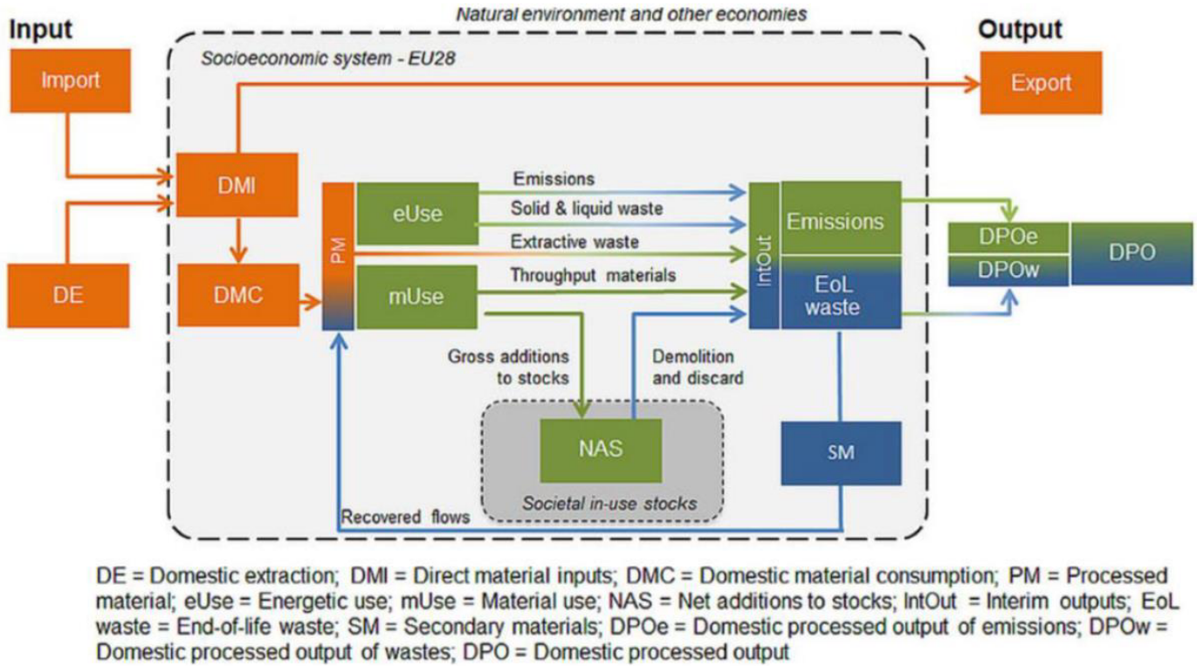
Digression: We already encountered this Perspective

Slide 48
Why “older” (pre-sustainability) Management Approach?
Institutionalised management instruments
Notes:
1972: Erste UN-Umweltkonferenz (Stockholm)
1972 Limits of Growth
1977 in Hameln: HH Atomkraftgegner
Jahreswechsel 1983 zu 1984: Besetzung Stopfenreuther Au bei Hainburg

Slide 49
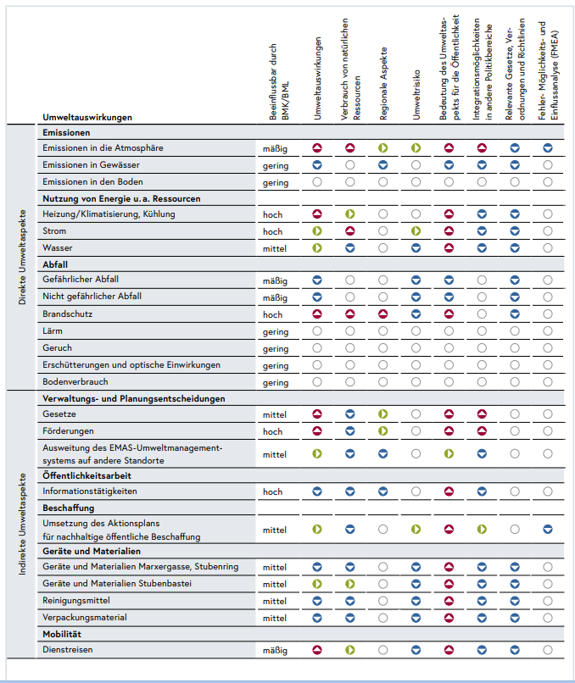
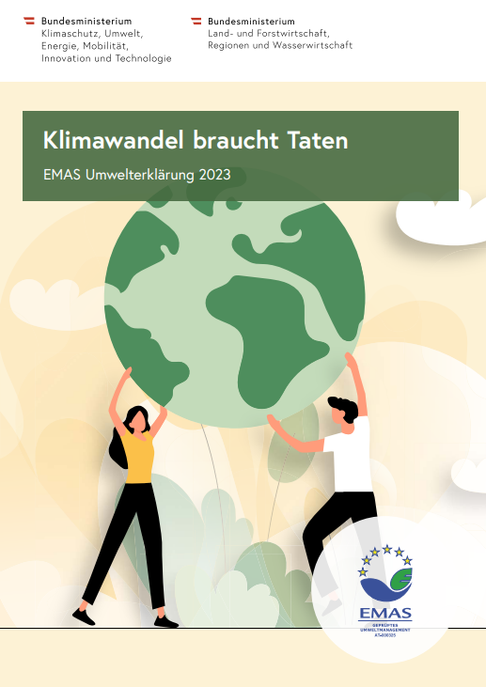
Environmental Management in Action

Slide 50
Wait – there is more: Sustainability Management

Slide 51
What is Sustainability Management?
🤔

Slide 52
What is Sustainability Management?
👉 apply sustainability principles when governing organsiations
Main goal: balance economic growth, social equity, and environmental protection to ensure long-term viability and resource availability for future generations
Economic Growth: Ensuring long-term profitability and resource efficiency
Social Equity: Addressing social impacts and ensuring fair practices
Environmental Protection: Reducing emissions and conserving natural resources
👉 strategic integration of these 3 dimensions into organizational decision-making

Slide 53
Digression: Nature & the Environment
Perspective 👉 | Ecological Perspective | Regulatory/Legal Perspective | Corporate Sustainability Perspective | Socio-economic Perspective | Systems Thinking Perspective
Understanding of Environment | natural environment: air, water, soil, biodiversity & ecosystems | Sum of laws & policies referring to: air, water, land, & living organisms | natural & operational surroundings affected by corporate activities | interaction between human societies & natural systems in general | complex system of interrelated natural and human-made components
Examples | Biodiversity conservation, habitat protection, ecosystem restoration | ISO 14001 Environmental Management Systems, EU Green Deal | Environmental, Social, Governance (ESG) & Corporate Social Responsibility (CSR) policies / reprtings | Sustainable cities, circular economy, climate adaptation /mitigation policies | Life Cycle Assessments (LCA), Industrial Ecology, Sustainable Supply Chains

Slide 54
The new Kid on the Block?
Environmental management tools
Notes:
1972: Erste UN-Umweltkonferenz (Stockholm)
1972 Limits of Growth
1977 in Hameln: HH Atomkraftgegner
Jahreswechsel 1983 zu 1984: Besetzung Stopfenreuther Au bei Hainburg

Slide 55
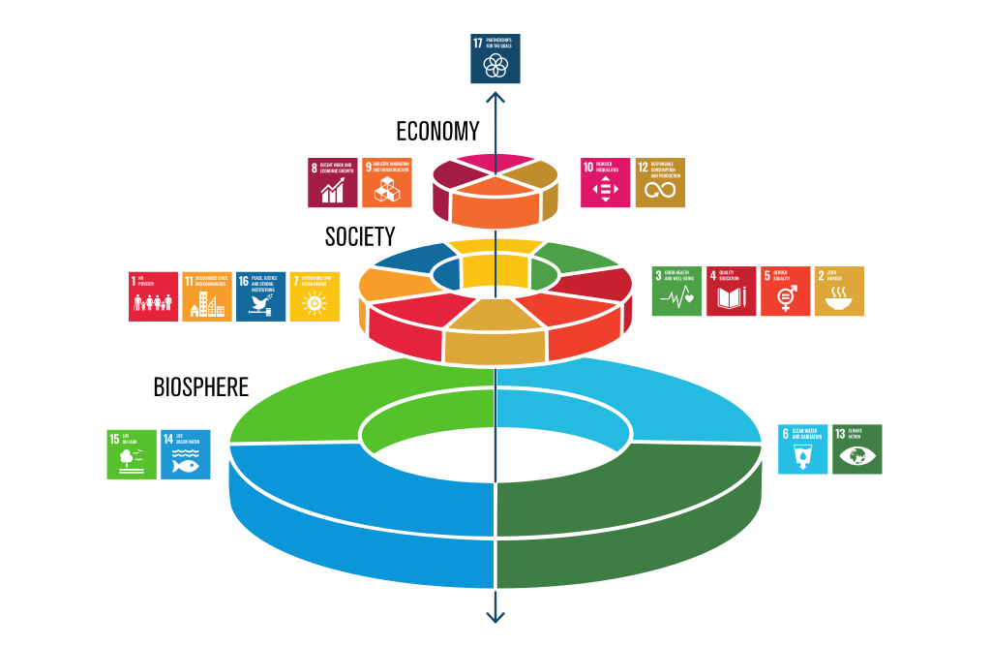
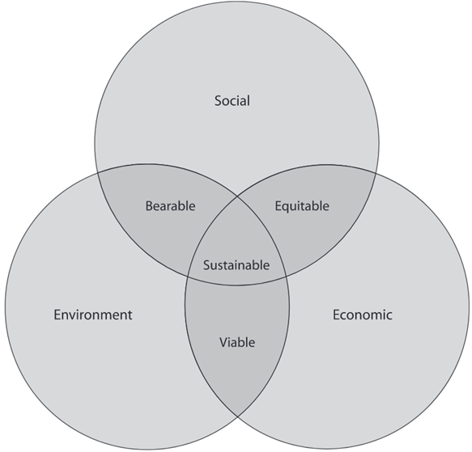
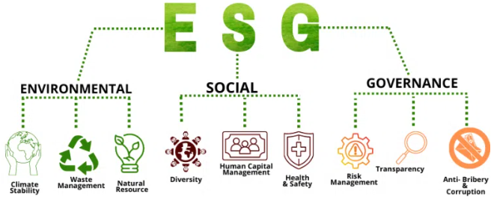
Associated Frameworks
Notes:
1994: Elkingtons Triplle bottom line
2015: SDGs
~ 2004: ESG

Slide 56
The new Kid on the Block?
Environmental management tools
Standardised ESG reporting
Notes:
1972: Erste UN-Umweltkonferenz (Stockholm)
1972 Limits of Growth
1977 in Hameln: HH Atomkraftgegner
Jahreswechsel 1983 zu 1984: Besetzung Stopfenreuther Au bei Hainburg

Slide 57
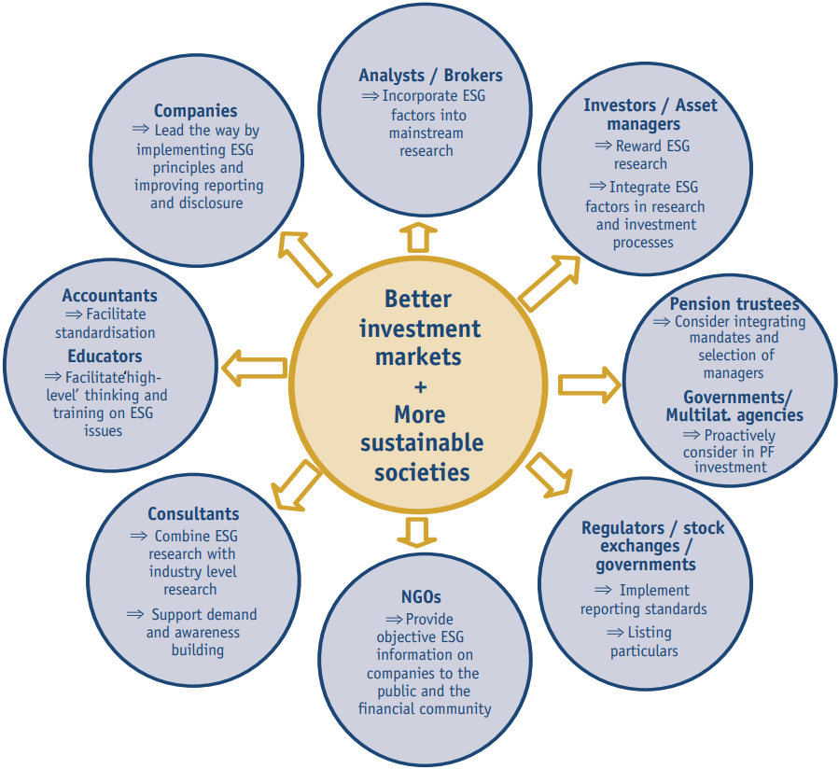
Digression: ESG?
“Companies are asked to take a leadership role by implementing environmental, social and corporate governance principles and polices and to provide information and reports on related performance in a more consistent and standardised format.” (UN Global Compact, 2004: II)
Stronger and more resilient financial markets
Contribution to sustainable development
Awareness and mutual understanding of involved stakeholders
Improved trust in financial institutions

Slide 58
Some Strands in Understanding Sustainability Management
Preservation of capital:
activities and processes aimed at achieving sustainable development by preserving both manufactured and natural capital
Stakeholder needs:
meeting the needs of an organization’s stakeholders - such as employees, society, customers, suppliers, and government - without compromising the ability to meet future stakeholders' needs
Systems Thinking Approach:
illustrate interdependencies among ecosystems, societies, organizations, and individuals 👉 need for holistic strategies to achieve sustainability goals

Slide 59
Who is Charge?
🤔

Slide 60
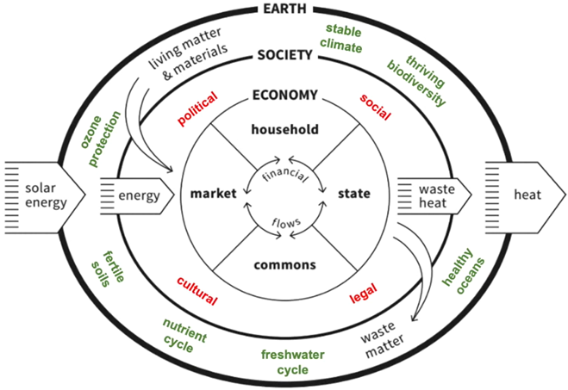
Who is Charge?

Slide 61
Who is Charge?
👉 Organisations!
structured group of individuals working together to achieve specific objectives.
defined system of rules
roles, and
relationships
“a body of individuals working under a defined system of rules, assignments, procedures, and relationships designed to achieve identifiable objectives and goals.” (Greenwald, 2008)
👉 guide interactions & processes

Slide 62
Archetypical Organisations
Companies
Public Entities
NGOs

Slide 63
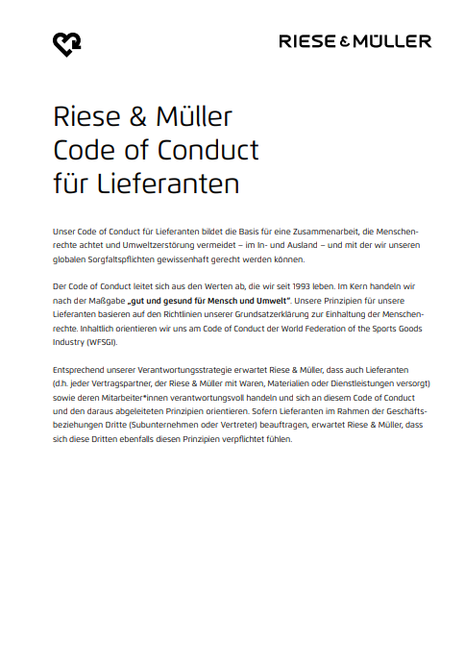

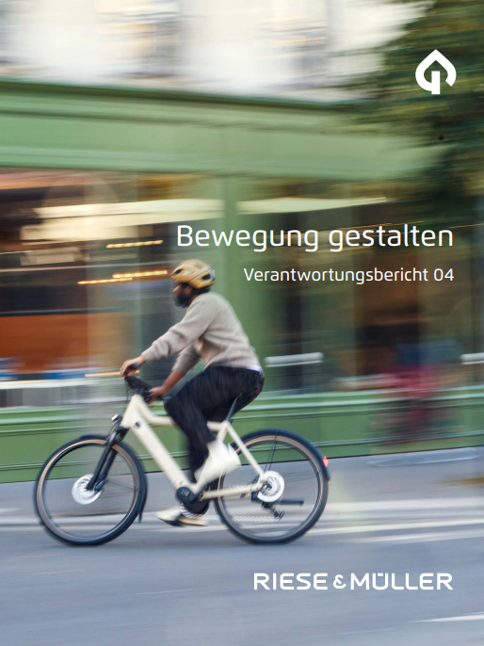
Sustainability Management in Action

Slide 64
Sus or Enviro … or both?

Slide 65
Same-Same, but different?
Aspect | Sustainability Management | Environmental Management
Definition | Strategic integration of environmental, social & economic considerations into decision-making 👉 long-term resilience | Managing environmental impacts & compliance with regulations 👉 minimize ecological harm
Main Goal | Long-term sustainable development balancing economic growth, social well-being & ecological integrity | Prevent, mitigate, and remediate environmental harm from human activities
Key Focus Areas | Environmental, Social, and Governance (ESG), Circular Economy, Corporate Social Responsibility (CSR), Stakeholder Engagement | Pollution control, waste management, biodiversity conservation, regulatory compliance

Slide 66
Same-Same, but different?
Aspect | Sustainability Management | Environmental Management
Regulatory vs. Voluntary | Often voluntary but influenced by global frameworks like the UN SDGs, ESG standards, and CSR policies | Regulation-driven, enforced through environmental laws and policies
Timeframe | Long-term focus on systemic change and sustainable business models | Short- to medium-term focus on managing environmental impacts & compliance
Application in Business | Integration into strategy, reporting, and innovation to enhance brand value & resilience | Manage emissions, waste & resource use to comply with laws & reduce risks
Examples | Patagonia’s Worn Wear Initaitive UN Sustainable Development Goals EU Corporate Social Responsibility Directive (CSRD) | Environmental Impact Assessments (EIA) ISO 14001 Environmental Management Systems Carbon footprint reduction programs

Slide 67
Outlook

Slide 68
Wrap it up

Slide 69
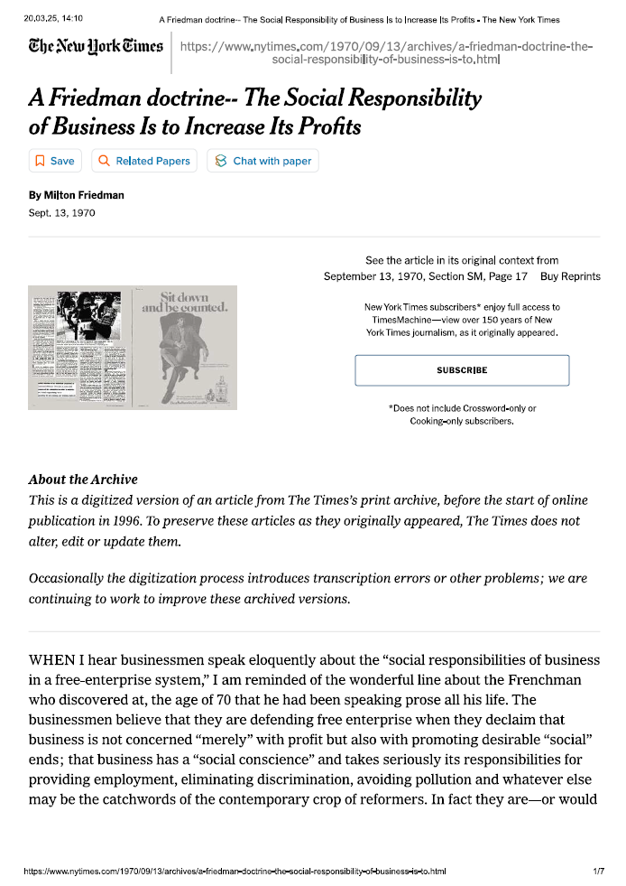
Till next Session:
https://www.nytimes.com/1970/09/13/ archives/a-friedman-doctrine-the-social-responsibility-of-business-is-to.html

Slide 70
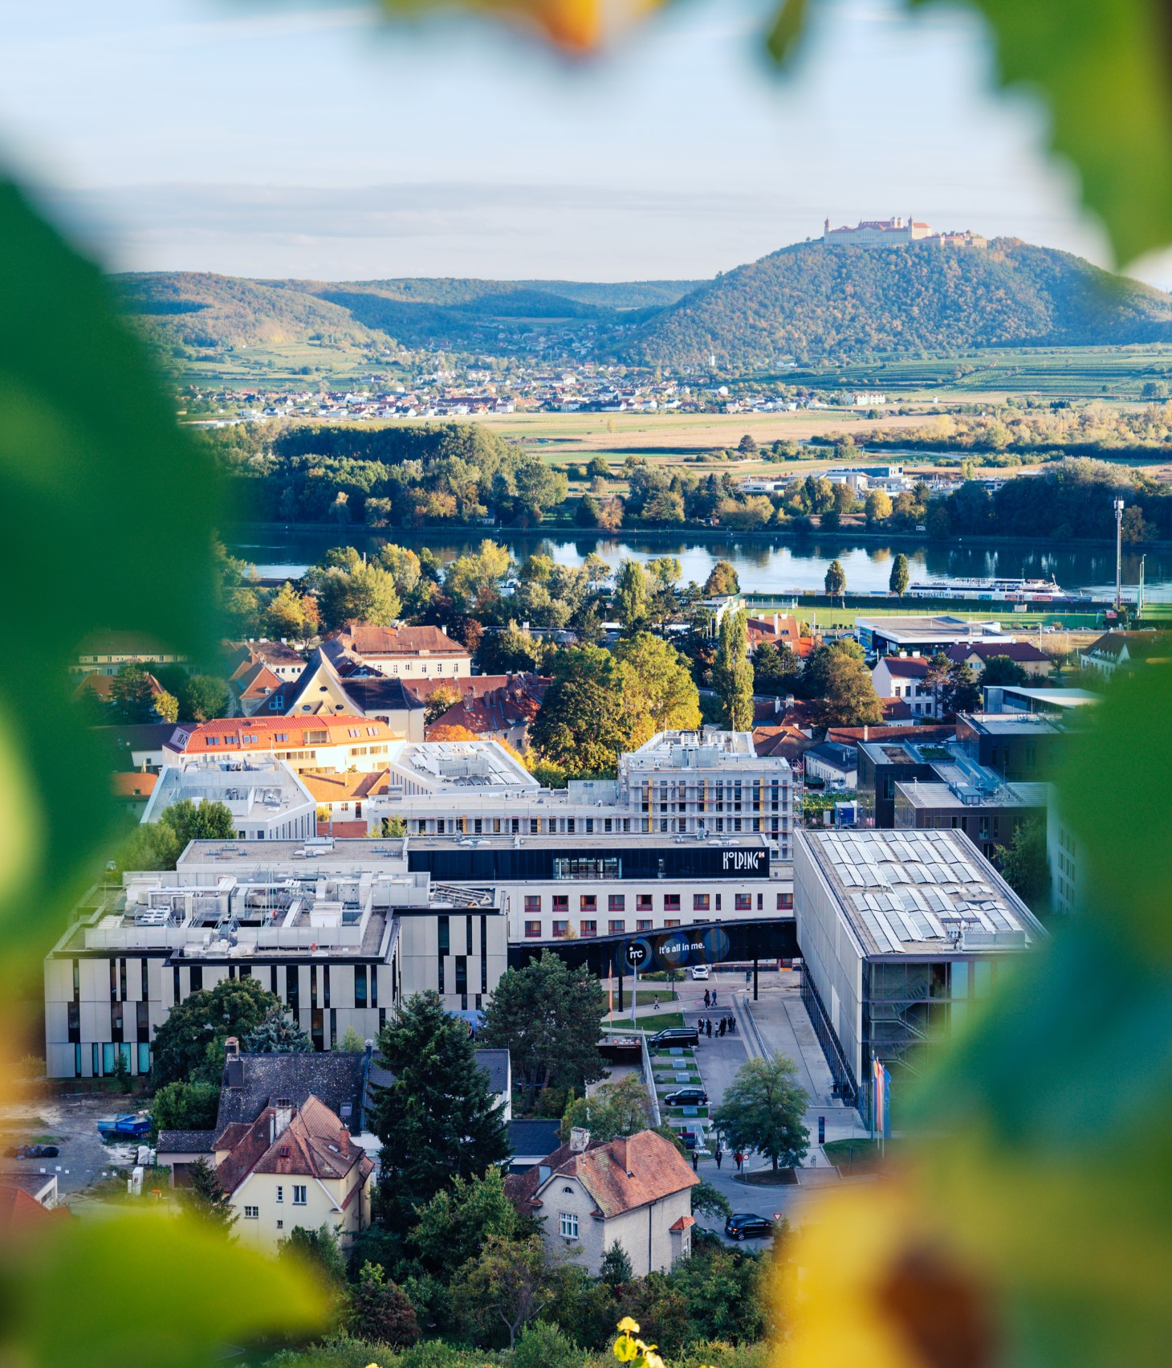

So long & cheerio!

